Slide 1
TOGETHER we lead and advance hydro-environment science and engineering

Slide 2
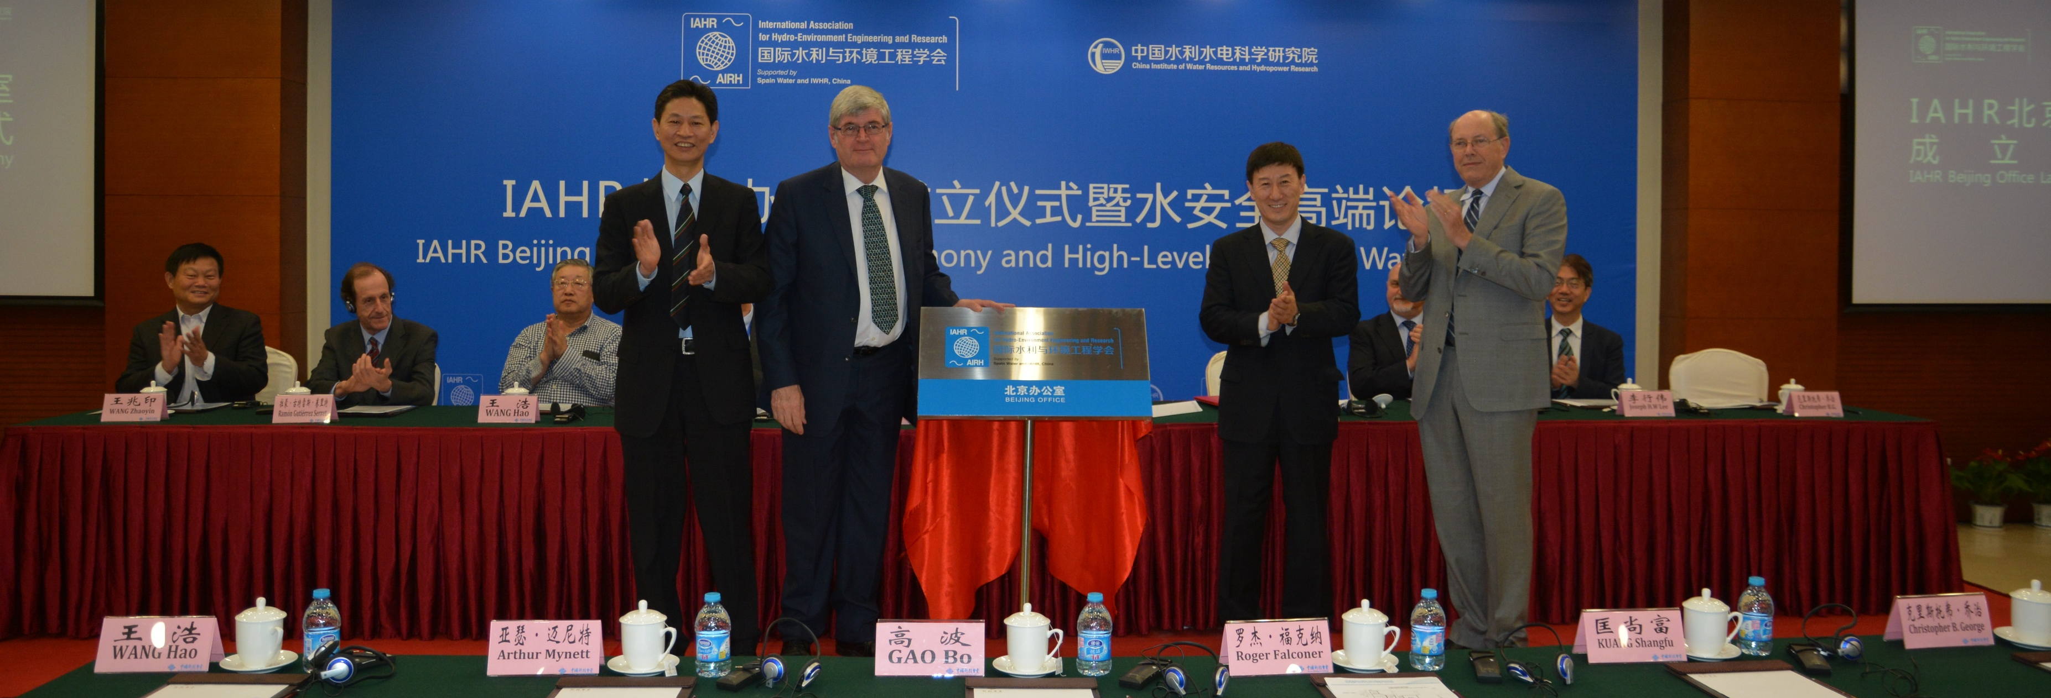
4235 Individual members
118 Institute members
53 Young professionals networks
We are IAHR
43 Council members
27 Technical committees & working groups

Slide 3
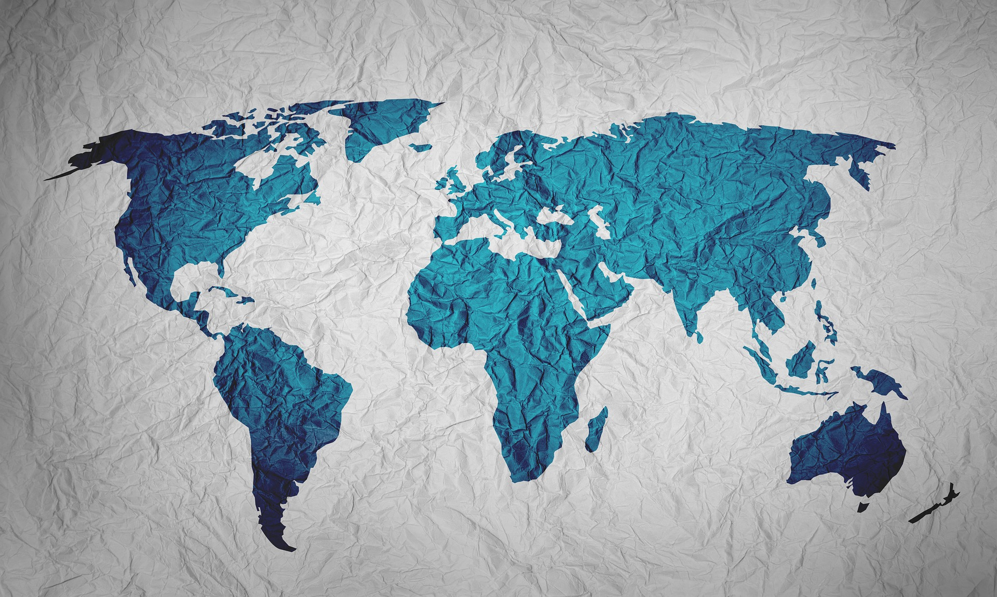
We are global
191 Countries
4 Regional Divisions
Europe
Asia-Pacific
Africa
Latin America

Slide 4
We are experts
Climate change adaptation
Hydroinformatics
Coastal & maritime hydraulics
Hydrometry
Drones in hydraulics
Ice research & engineering
Ecohydraulics
Industrial flows & energy exchange
Education & professional development
Marine outfall systems
Experimental methods & instrumentation
Nature based solutions
Flood risk management
Oil spill modelling
Fluid mechanics
Reservoir sedimentation
Sustainable Development Goals
Fluvial hydraulics
Global water security
Transient flows
Urban drainage
Groundwater hydraulics
Hydraulic machinery & systems
Water resources management
Water system operations

Slide 5
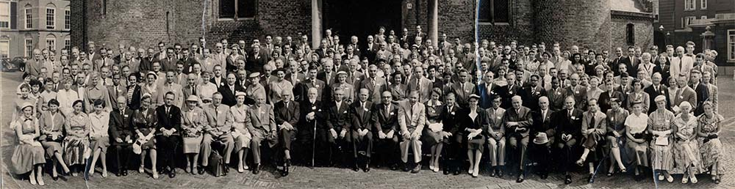
We are enduring
Established in 1935

Slide 6
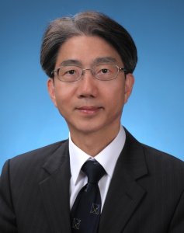
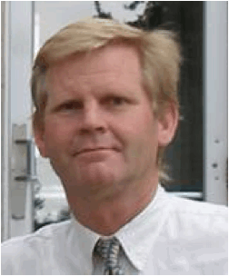
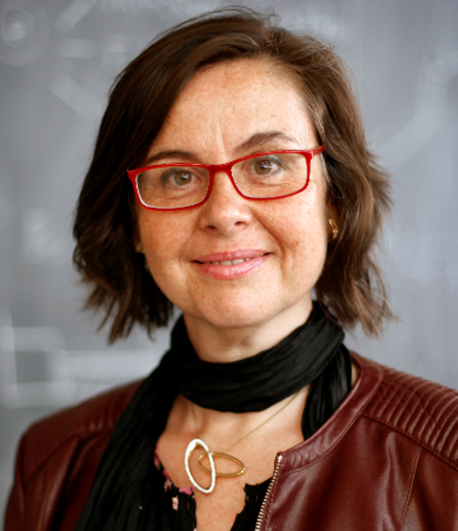
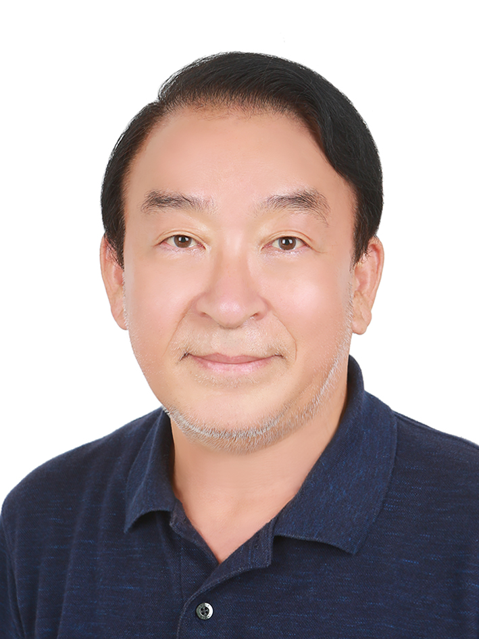
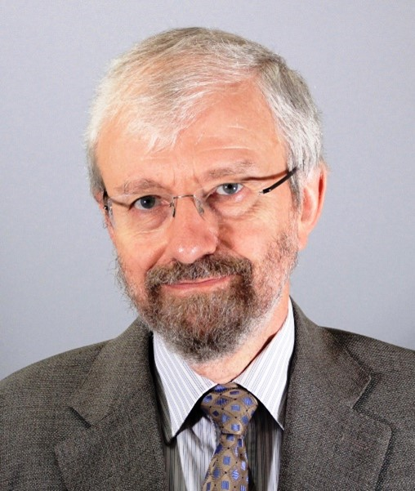
We are expertly guided
Prof Joseph Hun-Wei Lee President
Prof Robert Ettema Vice-President
Prof Amparo López Jiménez Vice-President
Prof Dr. Hyoseop Woo Vice-President
Dr Dominique Brocard Co-opted Vice-President
+ 2x Secretaries-General | 4x Division Chairs | 1x Executive Director

Slide 7
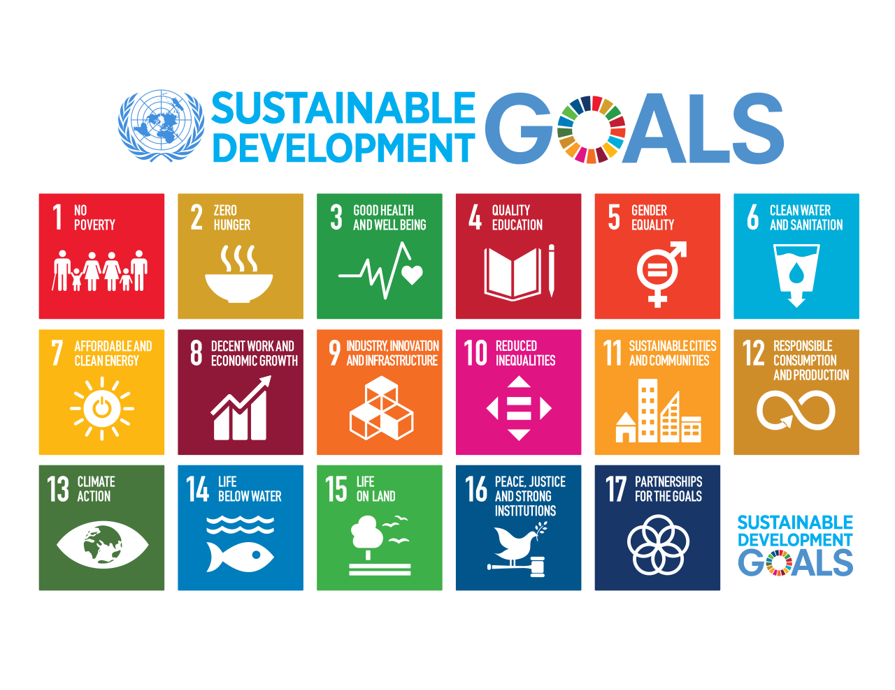
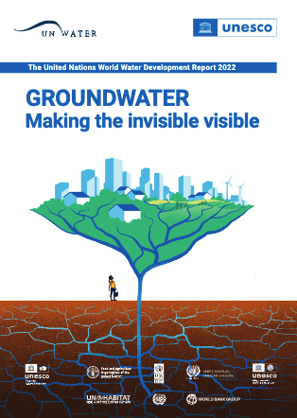
We are connected
We work with and support the international agenda on matters of global concern.

Slide 8
We are thought leaders
Hydrolink magazine
Peer-reviewed journals
Conference proceedings
White papers
Books and monographs

Slide 9
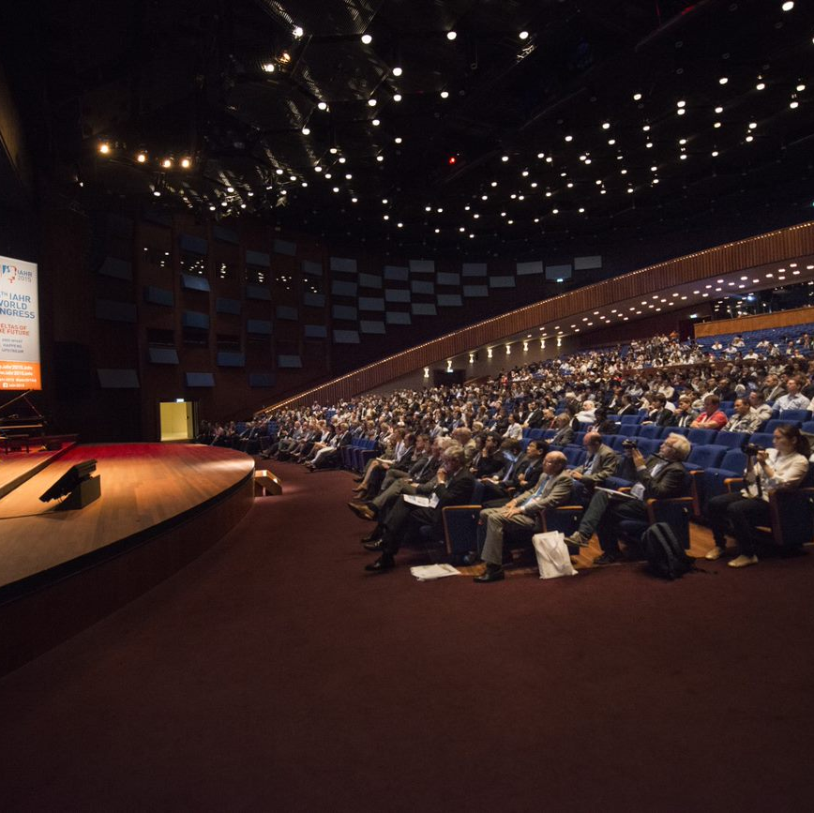
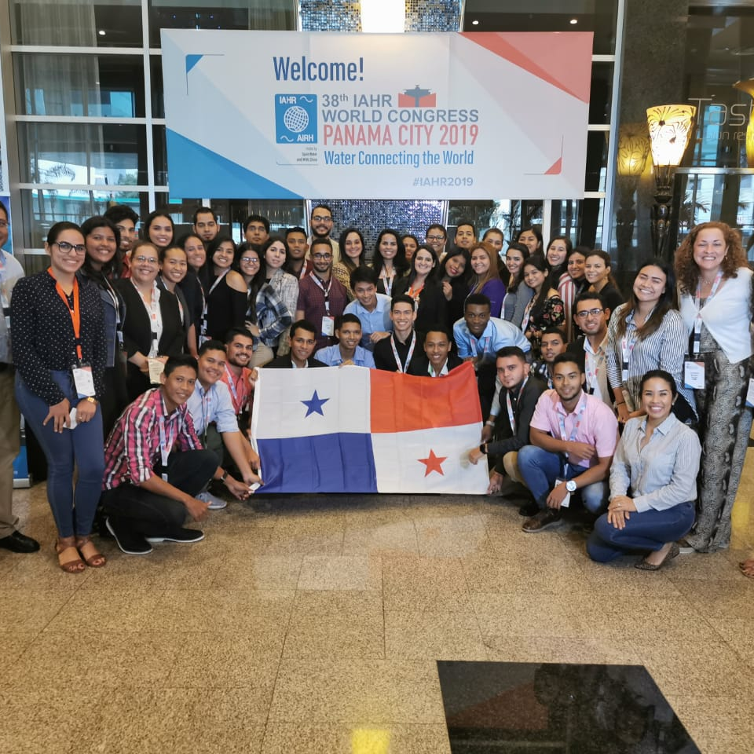
We are action-oriented
IAHR World Congress (~1200 attendees)
Regional Congresses
International Symposiums
Online Forum
Young Professionals Congress
Webinars and Workshops

Slide 10
We are advocates
We are a global voice on behalf of the hydro-environment industry and research community.

Slide 11
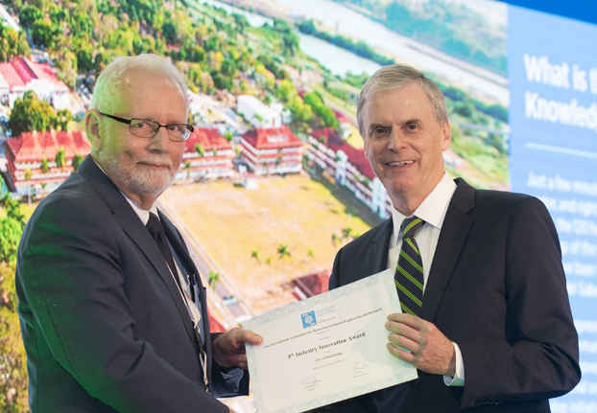
We are uplifting
We recognise the careers, papers, and projects of outstanding individuals and institutions.

Slide 12
We are driven
53 Young Professionals Networks
Networking events for young professionals
Training opportunities for young professionals
Peer-to-peer connection within and between regions

Slide 13
We are mentors
We support, guide and nurture the careers of new generations of hydro-environment professionals and researchers

Slide 14
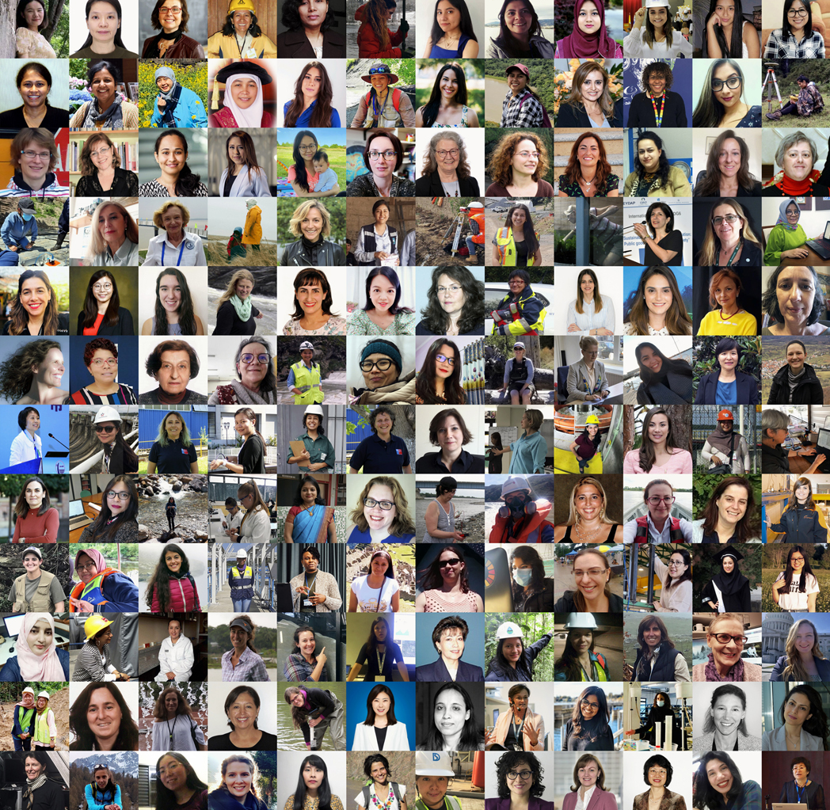
We are inclusive
We raise the profile and visibility of women and promote inclusion minorities and under-represented groups. We represent a range of different genders, ethnicities, professions and backgrounds.

Slide 15
We are social
@IAHR
IAHR Secretariat
@iahr_water
iahrbeijing
@IAHR.Water
International Association for Hydro-Environment Engineering and Research (IAHR)

Slide 16
We are open
We are always welcoming new individual and institute members and offering unmissable opportunities to collaborate and engage.
JOIN US TODAY!

