Slide 1
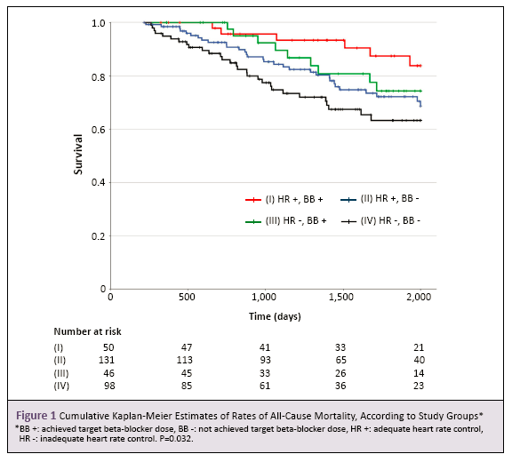
Please use font Arial, size 40 for the title.
Please use font SimSun, size 23 for the names and affiliations of all authors
Objectives
Example Example Example Example Example Example Example Example Example Example Example Example Example Example Example Example Example Example Example Example Example Example Example Example Example Example Example Example Example Example Example Example Example Example Example Example Example Example Example Example Example Example Example Example Example Example Example Example Example Example Example Example Example Example Example Example Example Example
Methods
Example Example Example Example Example Example Example Example Example Example Example Example Example Example Example Example Example Example Example Example Example Example Example Example Example Example Example Example Example Example Example Example Example Example Example Example Example Example Example Example Example Example Example Example Example Example Example Example Example Example Example Example Example Example Example Example Example Example
Results
Example Example Example Example Example Example Example Example Example Example Example Example Example Example Example Example Example Example Example Example Example Example Example Example Example Example Example Example Example Example Example Example Example Example Example Example Example Example Example Example Example Example Example Example Example Example Example Example Example Example Example Example Example Example Example Example Example Example Example Example Example Example Example Example Example Example Example Example
Conclusions
Example Example Example Example Example Example Example Example Example Example Example Example Example Example Example Example Example Example Example Example Example Example Example Example Example Example Example Example Example Example Example Example Example Example Example Example Example Example Example Example Example Example Example Example Example Example Example Example Example Example Example Example Example Example Example Example

