Slide 1
Accelerating Water Engineering and Science for Resilient Societies and Healthy Environments

Slide 2
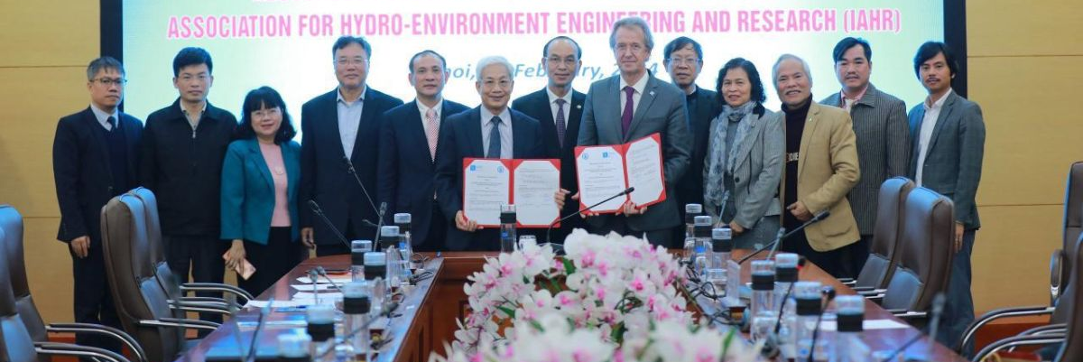
+5000 Individual members
121 Institute members
56 Young professionals networks
We are IAHR
43 Council members
27 Technical committees & working groups

Slide 3
We are global
191 Countries
6 Regional Divisions
Europe
North
America
Asia-Pacific
MENA
Africa
Latin America

Slide 4
We are experts
Climate change adaptation
Hydroinformatics
Coastal & maritime hydraulics
Hydrometry
Drones in hydraulics
Ice research & engineering
Ecohydraulics
Industrial flows & energy exchange
Education & professional development
Marine outfall systems
Experimental methods & instrumentation
Nature based solutions
Flood risk management
Oil spill modelling
Fluid mechanics
Reservoir sedimentation
Sustainable Development Goals
Fluvial hydraulics
Global water security
Transient flows
Urban drainage
Groundwater hydraulics
Hydraulic machinery & systems
Water resources management
Water system operations

Slide 5
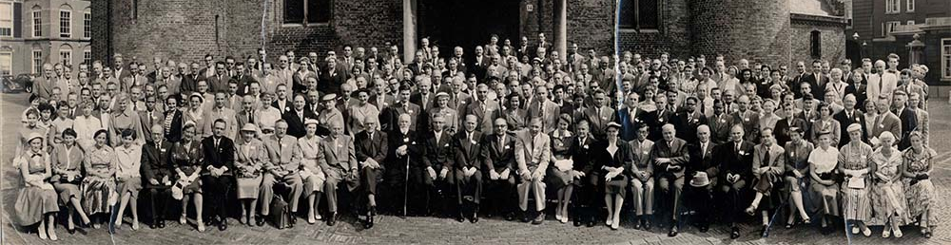
We are enduring
Established in 1935

Slide 6
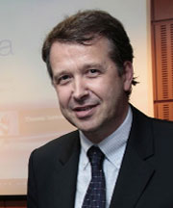
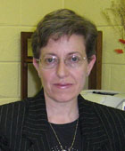
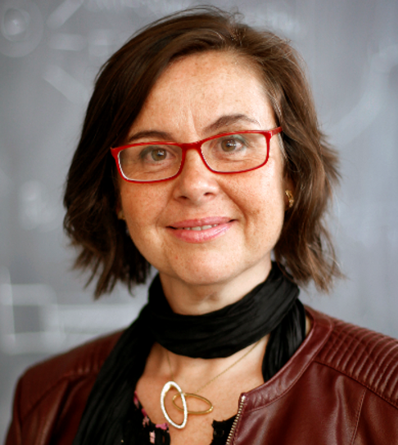
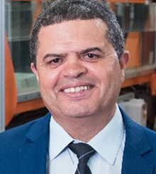
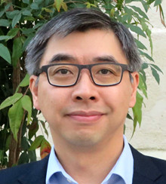
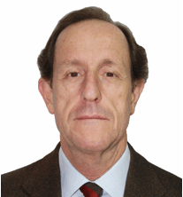
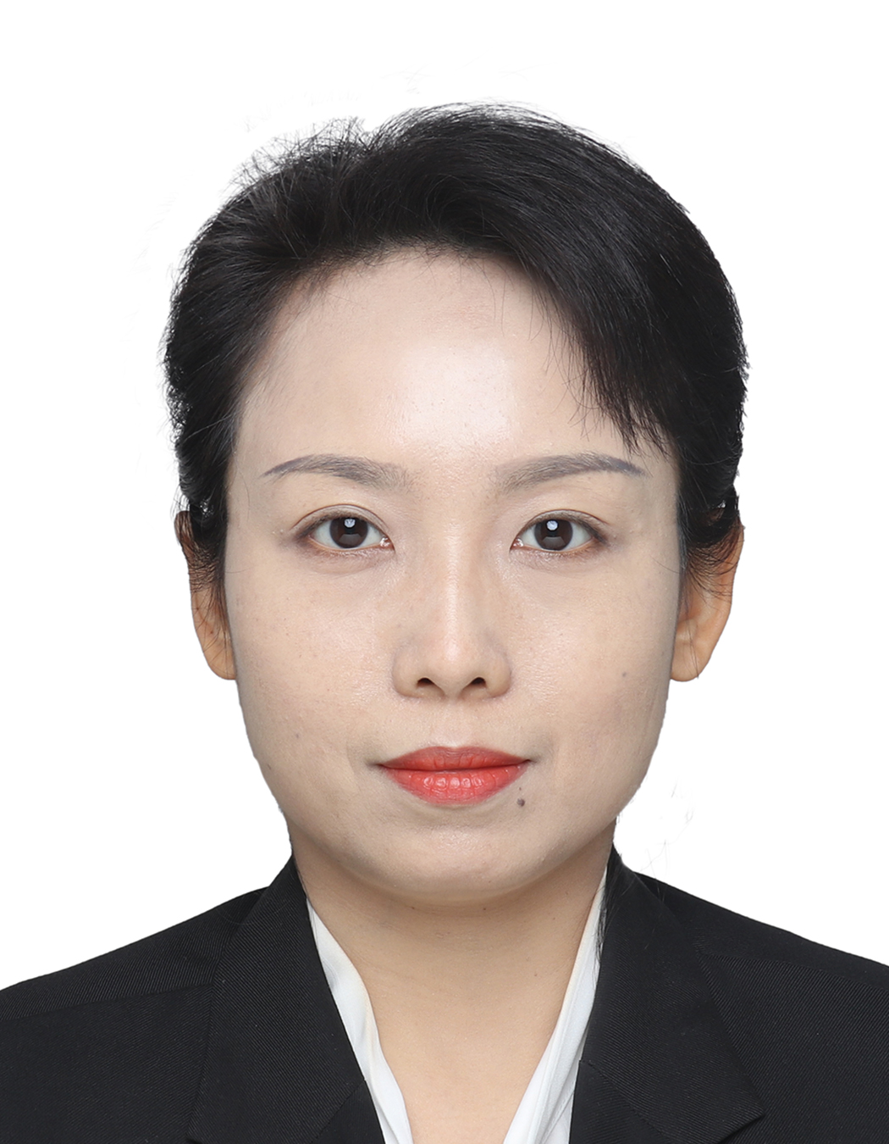
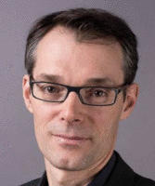
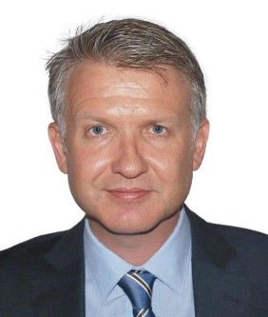
We are expertly guided
Prof. Philippe Gourbesville President
Dr. Ana Maria Ferreira da Silva Vice-President
Prof. Amparo López Jiménez Vice-President
Prof. Mohamed S. Ghidaoui Vice-President
Tom Soo Executive Director
Ramón Gutiérrez Serret Secretary General
Emily Wang Secretary General
Guillaume Stahl Co-opted member
Lance Gore Co-opted member

Slide 7
We are connected
We work with and support the international agenda on matters of global concern.

Slide 8
We are thought leaders
Hydrolink magazine
Peer-reviewed journals
Conference proceedings
White papers
Books and monographs

Slide 9
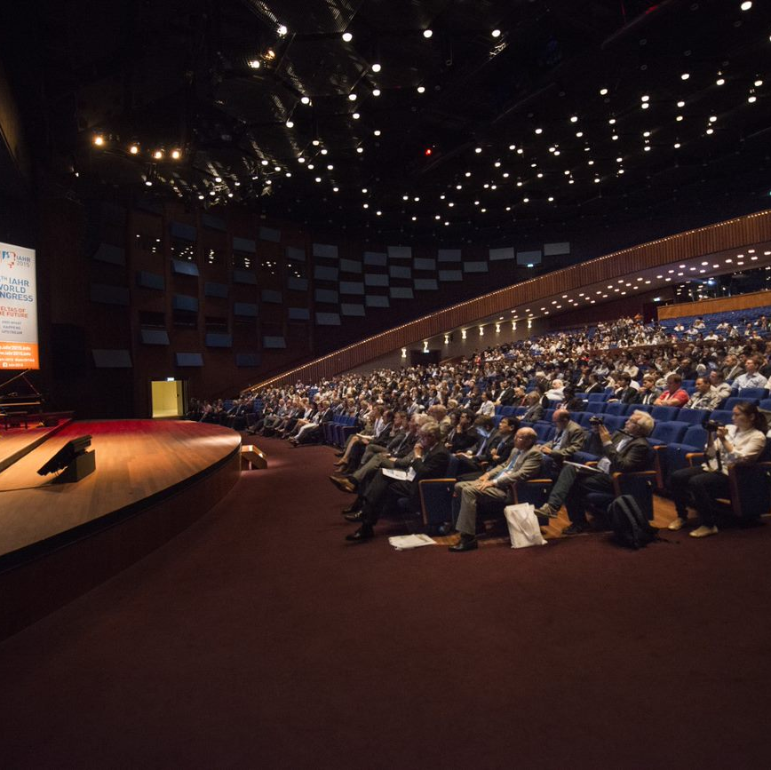
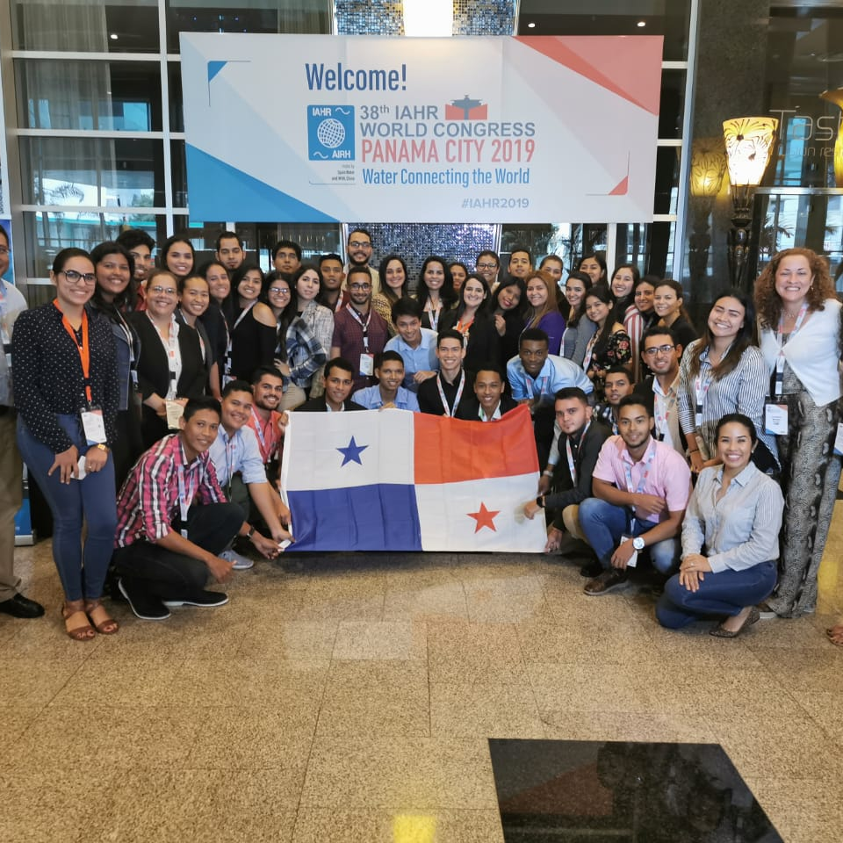
We are action-oriented
IAHR World Congress (~1400 attendees)
Regional Congresses
International Symposiums
Online Forum
Young Professionals Congress
Webinars and Workshops

Slide 10
We are advocates
We are a global voice on behalf of the hydro-environment industry and research community.

Slide 11
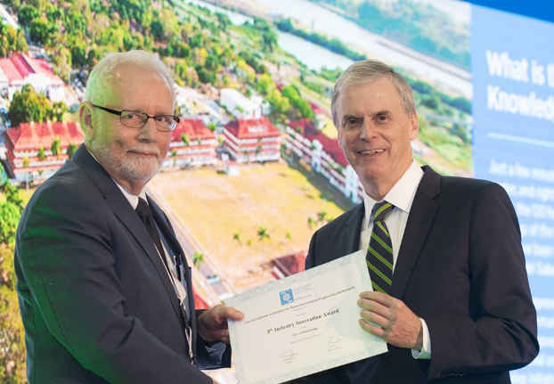
We are uplifting
We recognise the careers, papers, and projects of outstanding individuals and institutions.

Slide 12
We are driven
56 Young Professionals Networks
Networking events for young professionals
Training opportunities for young professionals
Peer-to-peer connection within and between regions

Slide 13
We are mentors
We support, guide and nurture the careers of new generations of hydro-environment professionals and researchers

Slide 14
We are inclusive
We raise the profile and visibility of women and promote inclusion minorities and under-represented groups. We represent a range of different genders, ethnicities, professions and backgrounds.

Slide 15
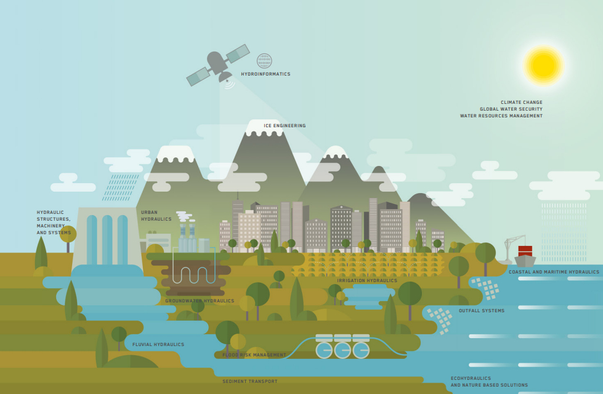
We are holistic
As the only global water association focused on research, innovation, and engineering across all sectors of the entire water cycle, IAHR seeks to grow the collective knowledge, influence and capacity of the sector to achieve holistic water outcomes.

Slide 16
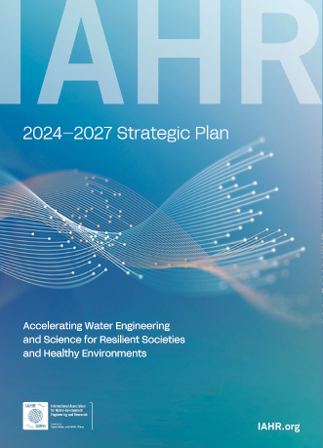
We are strategic
Today, more than ever water engineering stands out as a necessary field to re-shape our society and build a better future.
To meet actual challenges, IAHR has worked to define a forward-looking strategy: IAHR's 2024-2027 Strategic Plan

Slide 17
We are strategic
Our vision
Be the global hub of knowledge and innovation for holistic water engineering
Our mission
Foster vibrant expert communities
Convene leading events, educate and develop capacity
Publish best-in-field journals and cutting-edge knowledge products
build resilience by shaping cutting-edge knowledge towards market and society

Slide 18
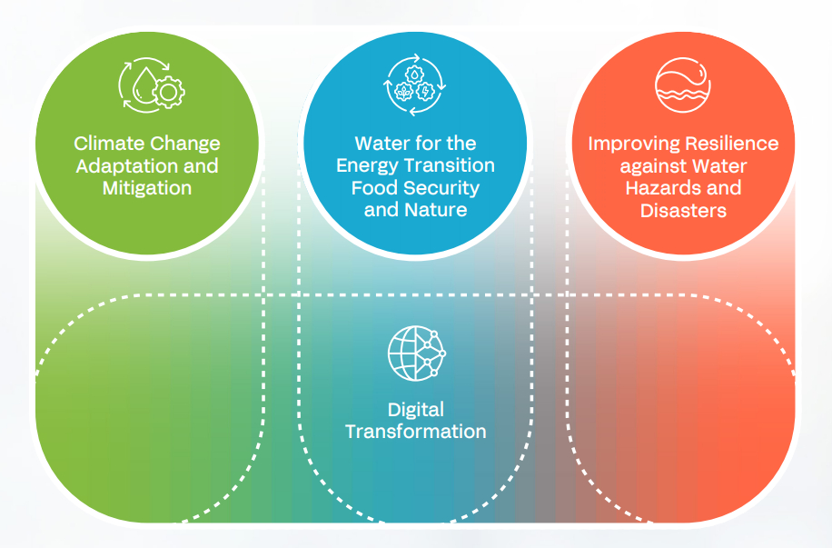
We are strategic
We aim to achieve our vision by uniting and focusing our collective capabilities on four thematic priority areas:
Climate Change Adaptation and Mitigation
Water for the Energy Transition, Food Security and Nature
Improving Resilience against Water Hazards and Disasters
Digital Transformation

Slide 19
We are community
Our association's strength emanates from the energy and drive of our members from around the world. Join us to Accelerate Water Engineering and Science for Resilient Societies and Healthy Environments!

Slide 20
We are social
@IAHR
IAHR Secretariat
@iahr_water
iahrbeijing
@IAHR.Water
International Association for Hydro-Environment Engineering and Research (IAHR)

Slide 21
We are open
We are always welcoming new individual and institute members and offering unmissable opportunities to collaborate and engage.
JOIN US TODAY!

