Slide 1
ICFM Webinar 15 Spain Floods of 2024
Slobodan P. Simonović
Chairperson of the ICFM Ad Hoc Committee
Western University
Institute for Catastrophic Loss Reduction
London, Ontario, Canada

Slide 2
ICFM10 update
Deadline extension Feb 28, 2025
Abstracts
Special sessions
Conference website is available at:
https://icfm10.com
Please register to receive regular updates
Submit an abstract
Submit a session proposal
May 20 – 22, 2026 see you in London (Canada)

Slide 3
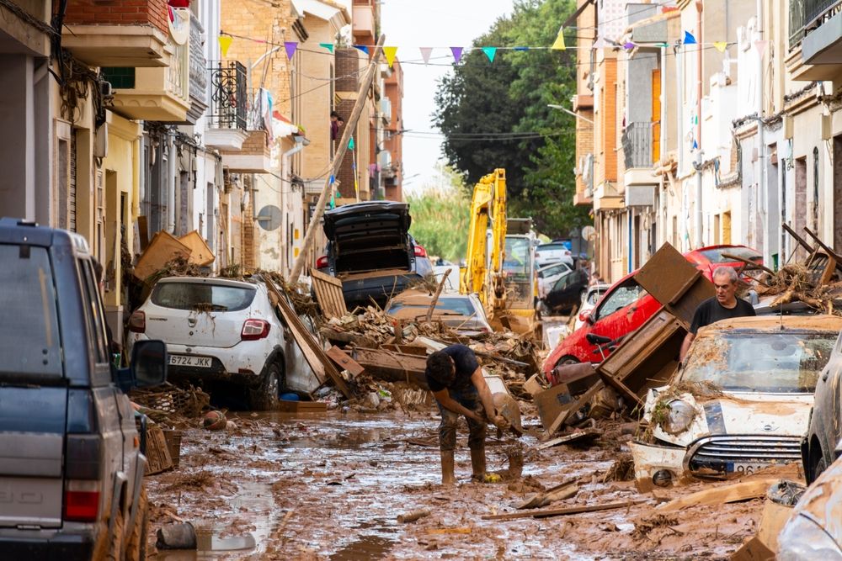
Webinar No.15 – Spain Floods of 2024
The Valencia floods of October 29 will go down in history as the deadliest disaster in modern Spanish history and the most catastrophic flood-related event in Europe in the past 50 years, claiming the lives of more than 229 people and creating €10 billion of damage
A year's worth of rain fell in one day
Communities struggle to recover

Slide 4
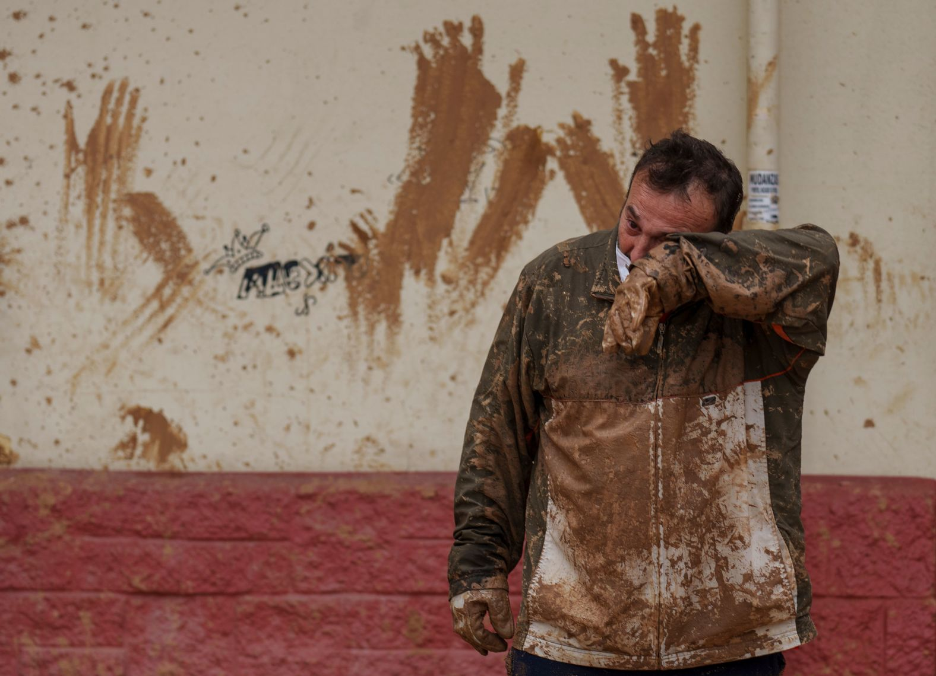
Webinar No.15 – Spain Floods of 2024
Politicians are involved in a blame game over who is responsible
Scientists work to understand the causes and scale of the disaster
The Mediterranean is one of the most vulnerable regions
DANA weather systems occur when an area of low pressure gets cut off from the main flow of the jet stream. This leaves them stuck over an area, delivering rainfall for several days. When cold air high up in the atmosphere meets warm air from the Mediterranean, the storm intensifies.
Many questions remain open
Why loss of life?
How to recover?
Who is responsible for what?
How to deal with climate change (if it is to be
blamed)?
How to reduce vulnerability and increase resilience?
Notes:
This particular type of storm has become so common in Spain that residents have two shorthands for it: gota fría, or “cold drop,” and DANA, an acronym for “depresión aislada en niveles altos – depression isladaen niveles altos”, which translates to “isolated depression at high levels.” The phenomenon falls under the category of a cut-off low system in the English-speaking world.
Some blame climate change: “Climameter - a EUproject released a rapid attribution analysis, where they found that the DANA, the weather event responsible for the fl oods, had been 15% more intense due to climate change
Some scientists disagree. The DANA phenomena has been destructive to southeastern coast of Spain before — floods in 1957 and 1962 were destructive, with the latter killing over 500.
the problems with these catastrophic floods is that people have been living in areas prone to extreme weather "without taking it into account."
“We are really exposed to these types of floods, but we’ve spent decades building houses and infrastructure in areas where water is supposed to flow, regardless of that fact. Constructing in flood-prone areas
has increased our exposure to these weather events”

Slide 5
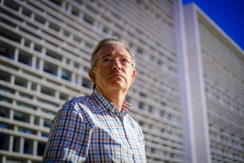
Webinar No.15 – Spain Floods of 2024
Speakers:
Dr. Félix Francés
Professor of Hydrology at UPV
Research Institute of Water and Environmental Engineering
Polytechnic University of Valencia, Valencia, Spain
Flood Risk Management and the October 2024 Flash Flood of Poyo Ravine in Valencia, Spain
Dr. Prieto Sierra Cristina
Director of Science in Hydrological Sciences and Hydrometeorological Hazards
Senior researcher
Instituto de Hidráulica Ambiental de la Universidad de Cantabria, Santander, Spain
Flash Floods: Advancing Methods and Case Studies in Northern Spain
Notes:
First hand response by local Spanish experts

