Slide 1
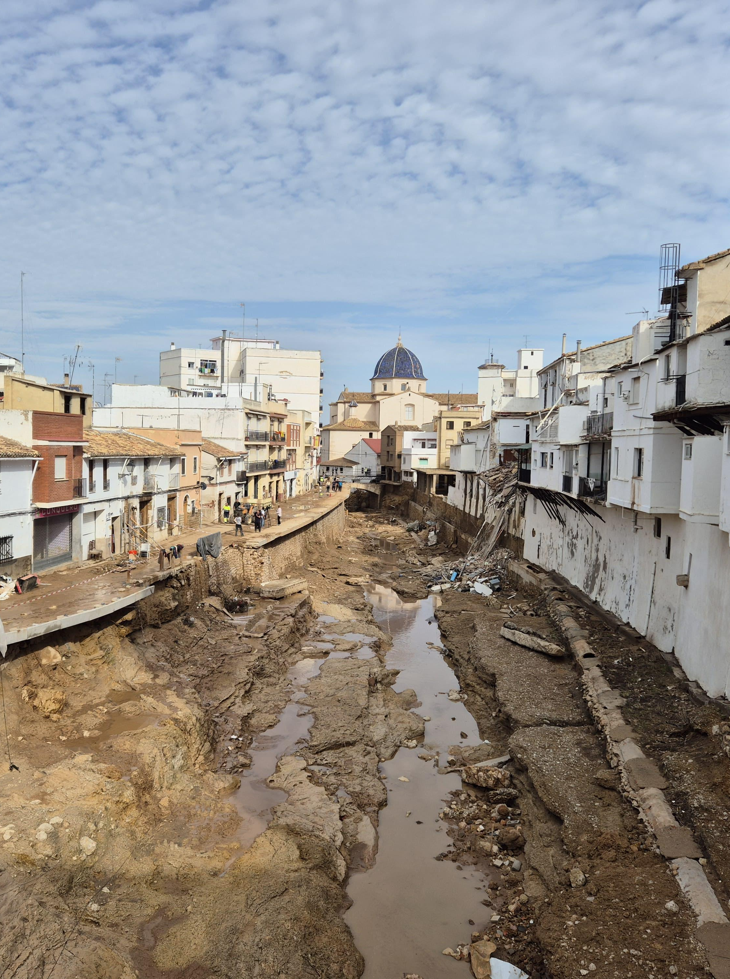


Flood Risk estimation and the October 2024 Flash Flood in the South of Valencia (Spain)
Prof. Félix Francés (ffrances@upv.es)
Research Institute of Water and Environmental Engineering (IIAMA)
Universitat Politècnica de València, Valencia, Spain

Slide 2
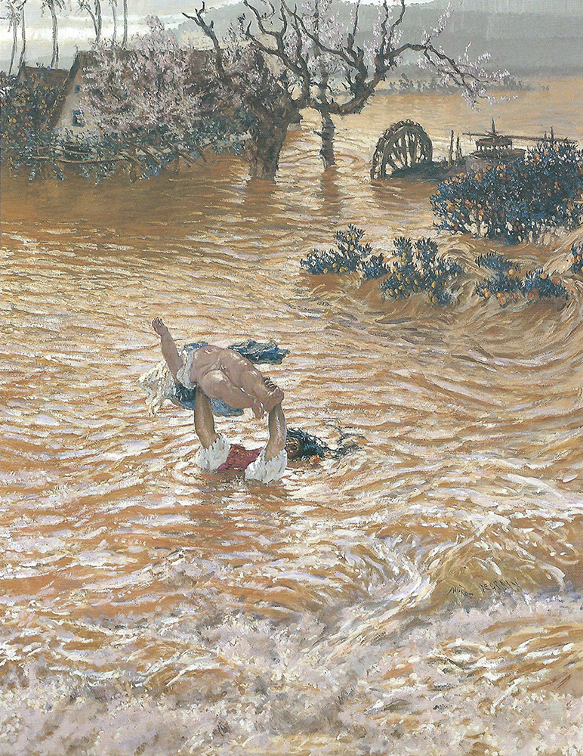
Outline of the presentation
The 2024 catastrophic event
Flood Hazard estimation in Poyo/Pozalet
Flood Risk estimation in Poyo/Pozalet
Conclusions
“Mother’s Love”, by Muñoz Degrain (1912), representing a large flooding of the orchards surrounding Valencia

Slide 3
The 2024 catastrophic event

Slide 4
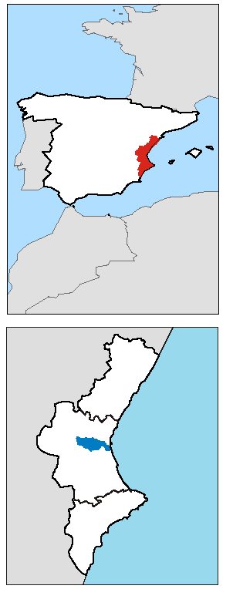
Drainage area of southern Valencia
Pozalet | 46.2 km2
Poyo | 369 km2
Picassent | 103.4 km2

Slide 5
The inundation area

Slide 6
Flash flood catchments
Quick flooding:
  Produced in small catchments in mountain areas
  Due to torrential rain and/or snowmelting with duration Usually, time of concentration
Usually, timescale of less than 6h => very short reaction time
With high flow velocities (destruction) and significant transport of sediment and debris (cleaning costs)

Slide 7
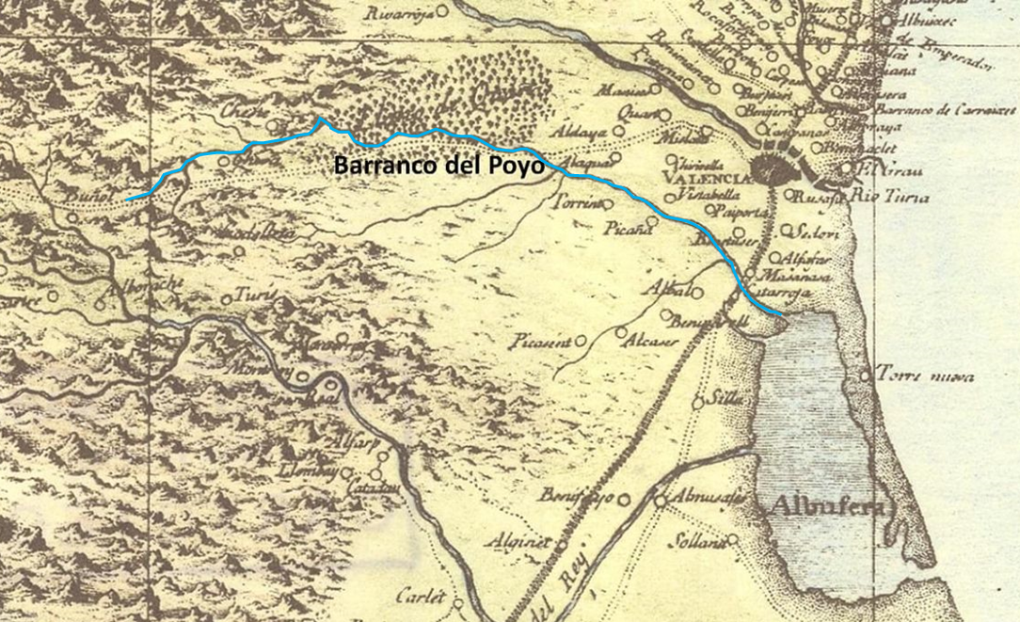
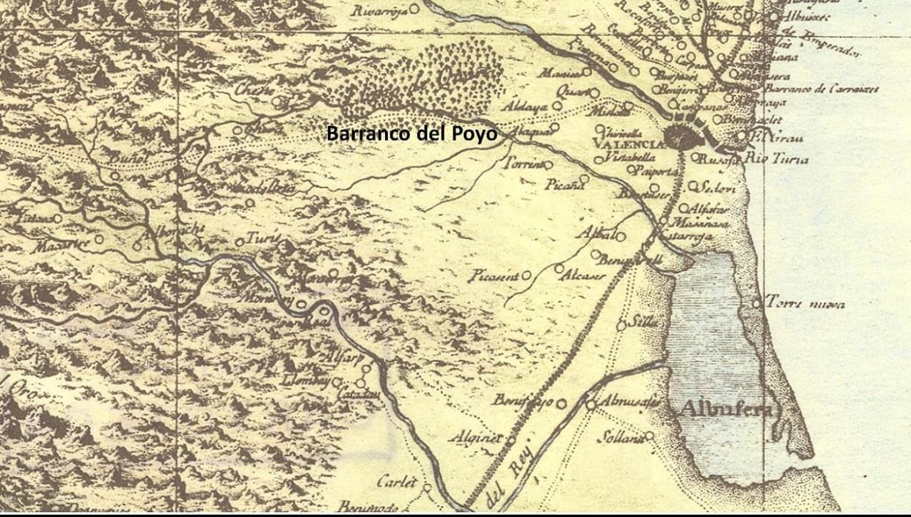
An “old friend”
el botánico, naturalista y geógrafo ilustrado José Antonio Cavanilles en 1795 del barranco de Poyo en "Observaciones sobre la historia natural, geografía, agricultura, poblaciones y frutos del Reyno de Valencia.
Naturalist J. A. Cavanilles in 1795 wrote about the Poyo Creek in “Observations on the natural history, geography, agriculture, populations and fruits of the Kingdom of Valencia”:
The botanist, naturalist and illustrated geographer J. A. Cavanilles in 1795 wrote about the Poyo ravine in “Observations on the natural history, geography, agriculture, populations and fruits of the Kingdom of Valencia”:
“Siguiendo hacia el sur desde Alaquás como a un quarto de legua se atraviesa el barranco, que empieza en las montañas e Buñol con dirección a Chiva, entra en esta villa y continúa por el término de Cheste, donde recibe otro considerable: engrosado con este aeumento y con las vertiene de aquellos montes, cruza el llano de Quart junto a la venta de Poyo, pasa después por las cercanías de Torrent, que dexa a su derecha, como igualmente Catarroja, y desagua en la Albufera de Valencia. Su profundo y ancho cauce siempre está seco, salvo en las avenidas, quando recibe tantas aguas y corre tan furisoamente, que destruye quanto encuentra. En 1775 causó muchísimas esgracias en Chiva, sorprehendiendo a media noche sus vecinos; asoló un número considerable de edificios, esparciendo por mas de dos leguas los tristes despojos y los cadáveres de los pobres que no pudieron evitar la muerte. A la derecha del barranco y a muy corta distancia, bien que en un sitio elevado, está Torrent, la mayor población del reyno después de las ciudades y villas principales”

Slide 8
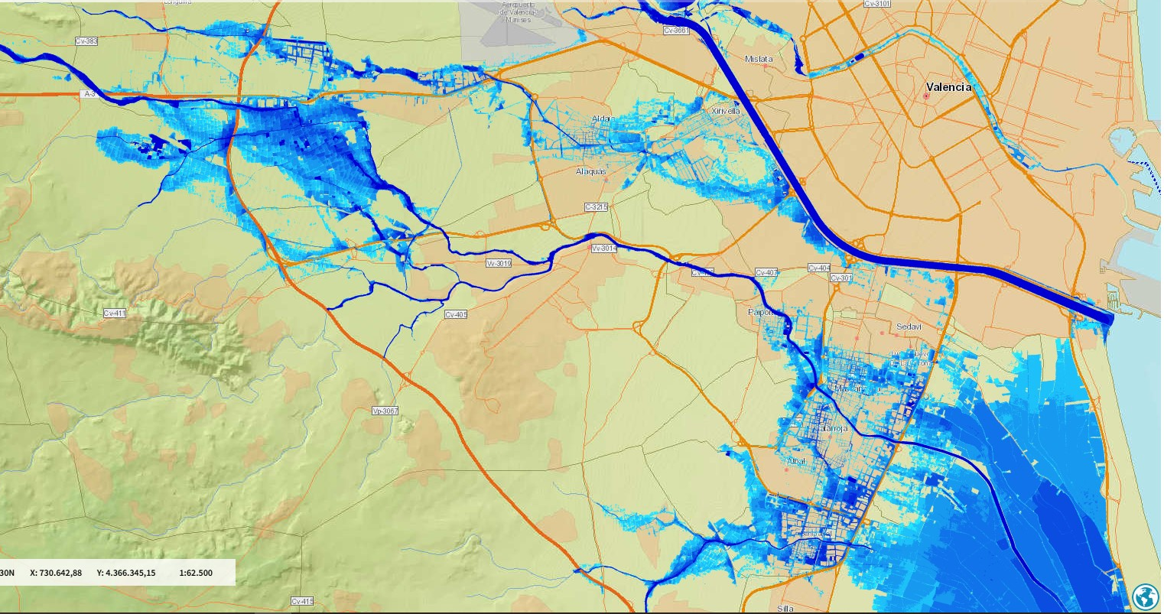
T500 flood hazard map
Application of European Directive 2007/60/EC on Flood Risk Assessment and Management
SAIH flow gauge station
V31 highway
Source: SNCZI 2nd cycle

Slide 9
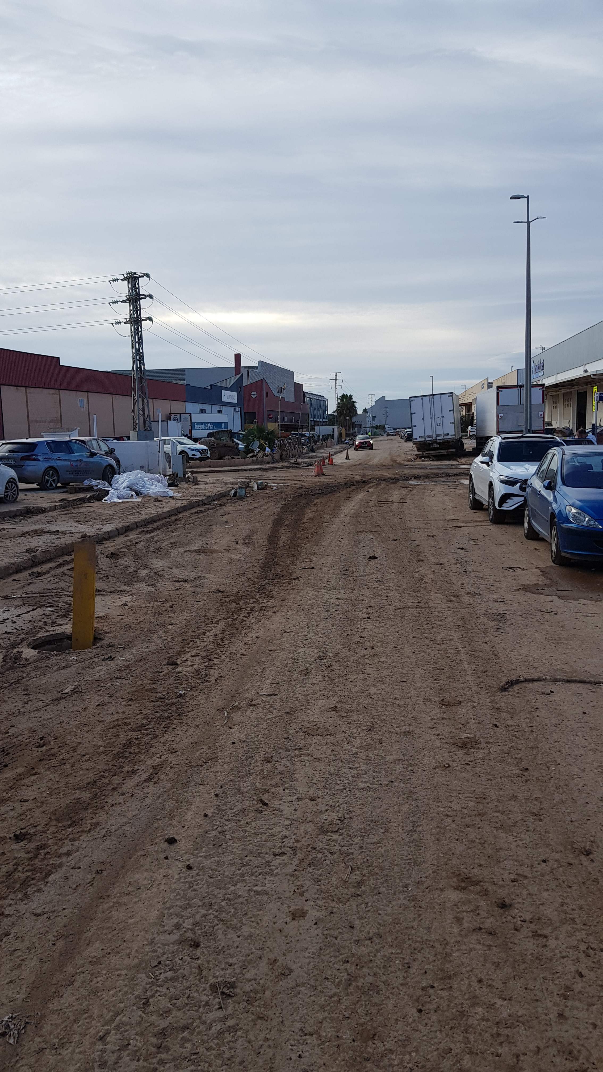
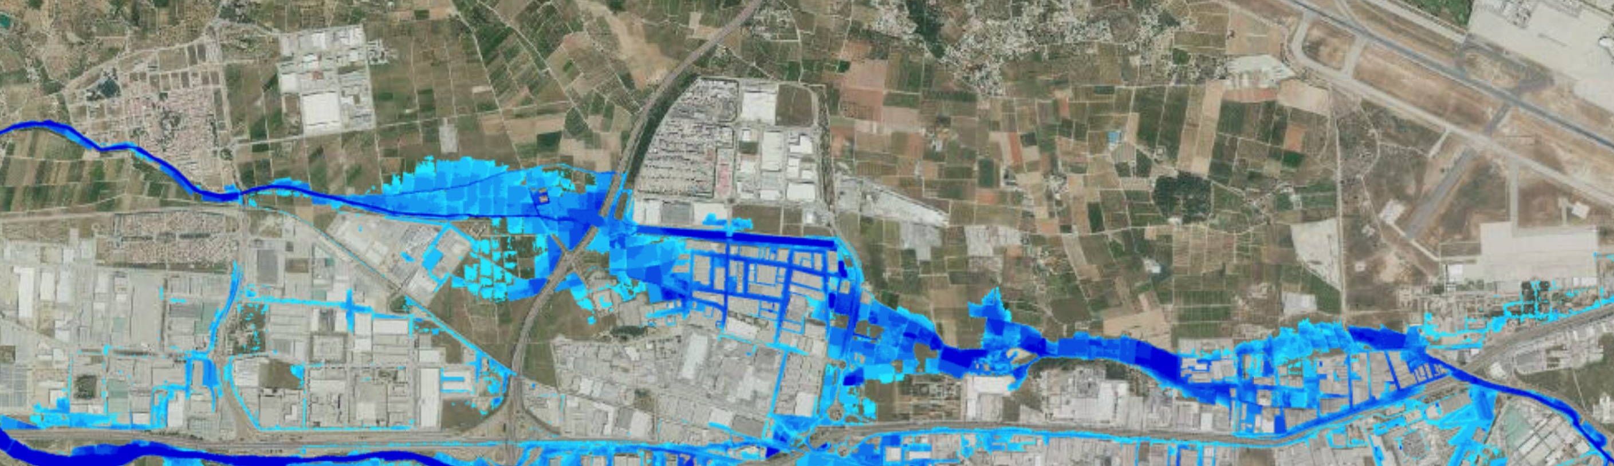
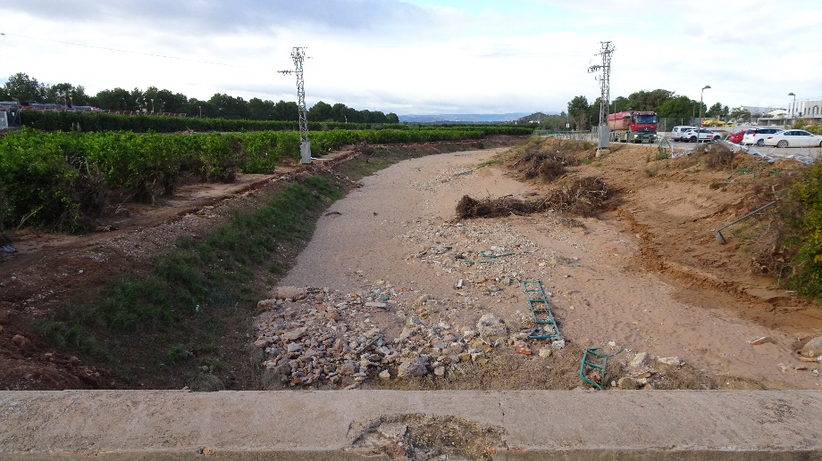
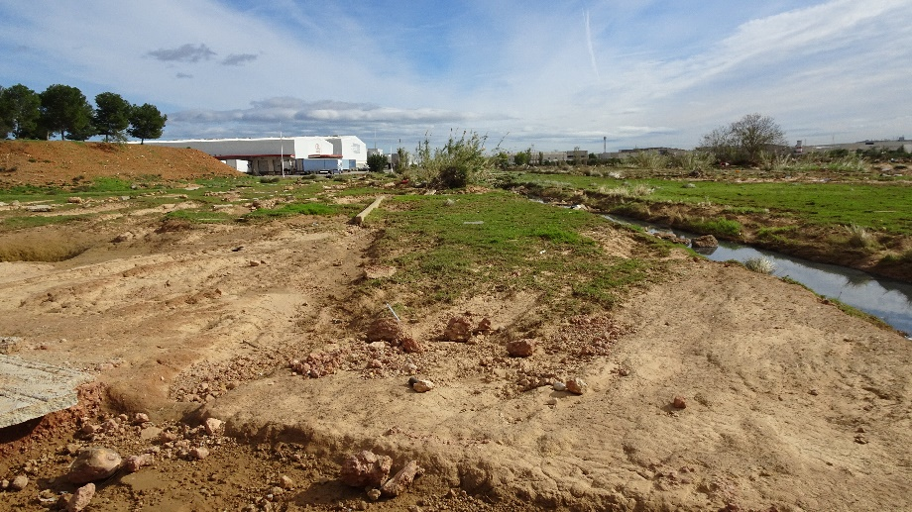
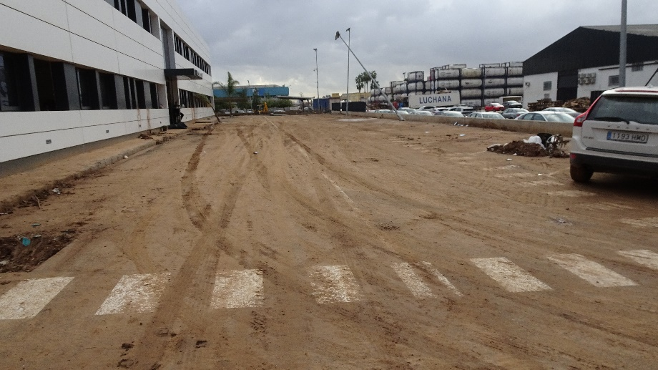
Evolution of Pozalet Ravine

Slide 10
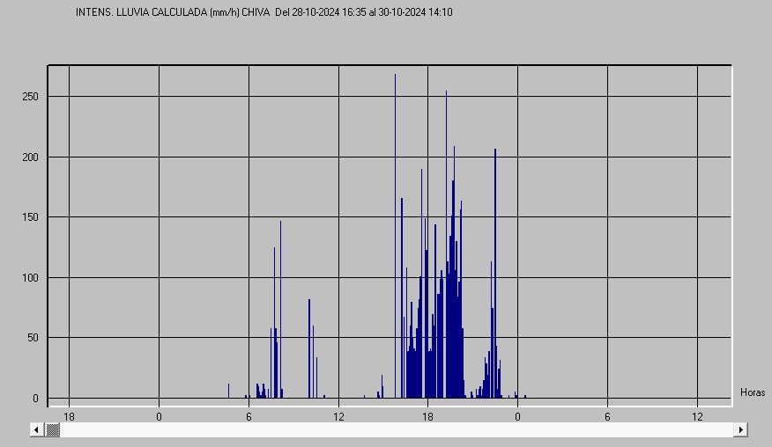
The precipitation on October 29, 2024
Storm duration = 5 hours
Maximum daily precipitation in Turis = 772 mm
No rain in flood prone area and no alert!

Slide 11
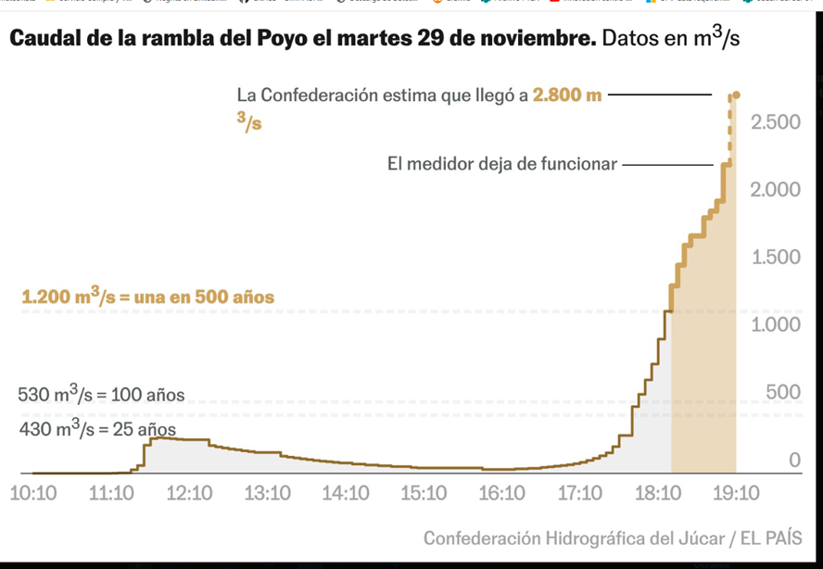
The flood on October 29, 2024
TETIS daily simulation with sediments at flow gauge station: 30% of sediments
Source: CHJ SAIH and El País
Peak discharge at flow gauge station (198 km2): aprox. 2,800 m3/s
Source: Francés et al., IIAMA , 2024

Slide 12
The flood on October 29, 2024
Return period between 2000 and 5000 years!
Source: CHJ SAIH and El País
Peak discharge at flow gauge station (198 km2): aprox. 2,800 m3/s
Source: Francés et al., IIAMA report, 2006

Slide 13
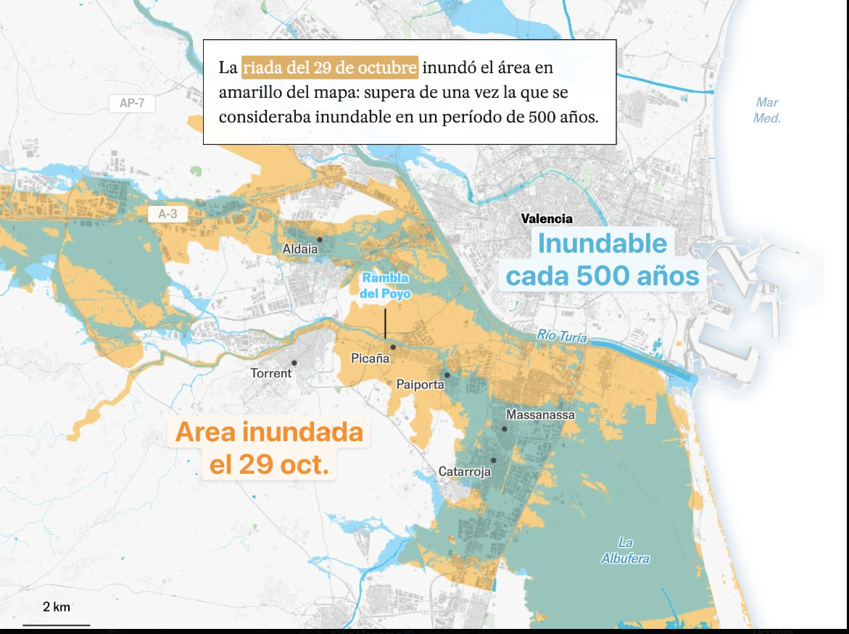
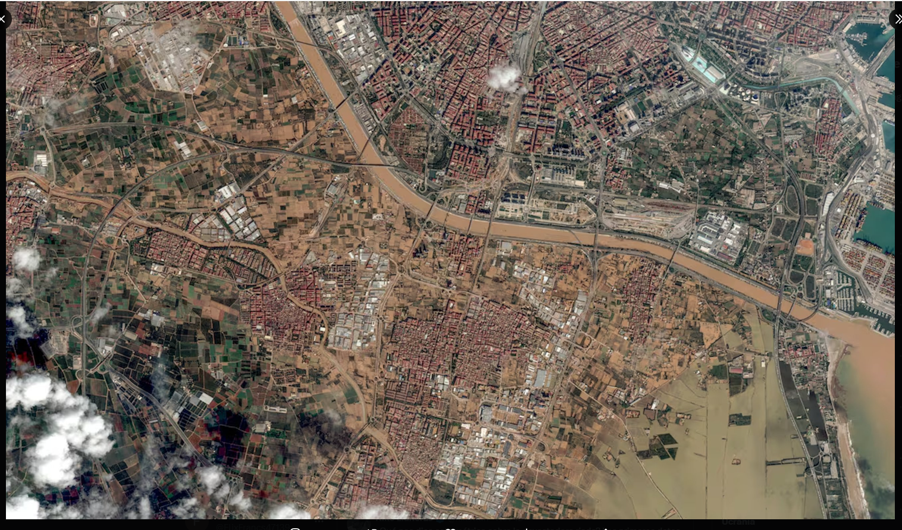
The inundation on October 29, 2024
Inundation was larger than the estimated for T500!
Peak total discharge crossing the V31 highway: aprox. 4,000 m3/s
Source: Copernicus and El País

Slide 14
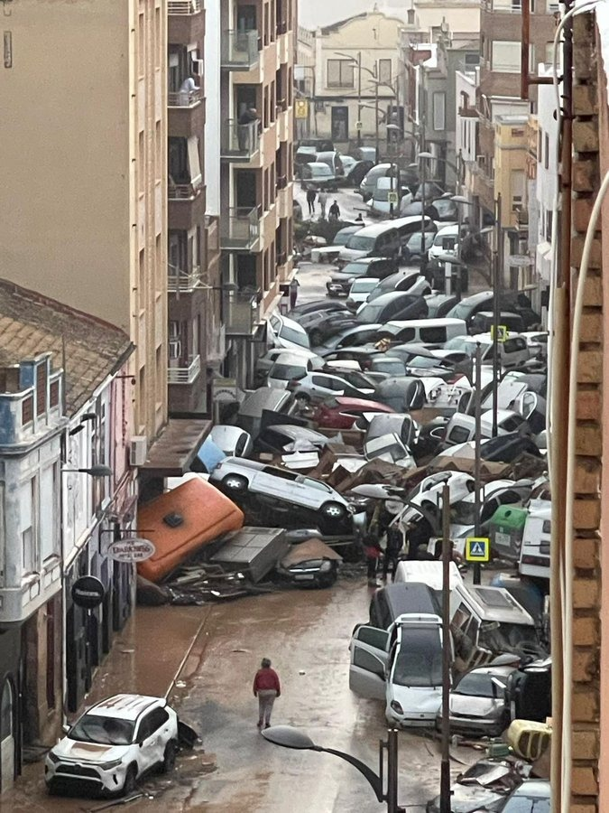
The catastrophe (provisional figures)
>350,000 people affected
> 40,000 houses damaged, mainly in ground floors
Thousands of industries with damages
20 large bridges and kilometers of roads and railway damaged or destroyed
> 100,000 cars washed away or severely damaged
During weeks, thousands of people cleaning the mud on streets and houses
Sewer system collapsed
223 victims (trap in ground floors, cars and underground garages)
Around 20,000 M€ only in direct damages

Slide 15
Flood Hazard in Poyo/Pozalet

Slide 16
Hydrological model calibration
Automatic calibration for TETIS hydrological model (Francés et al., 2007) in the Oct 2000 event at SAIH (Real Time Hydrological Information System) flow gauge station
Qmax obs (m³/s) | 538.75
Qmax sim (m³/s) | 534.67
Nash & Sutclife index | 0.82
Volume error % | 0.20

Slide 17
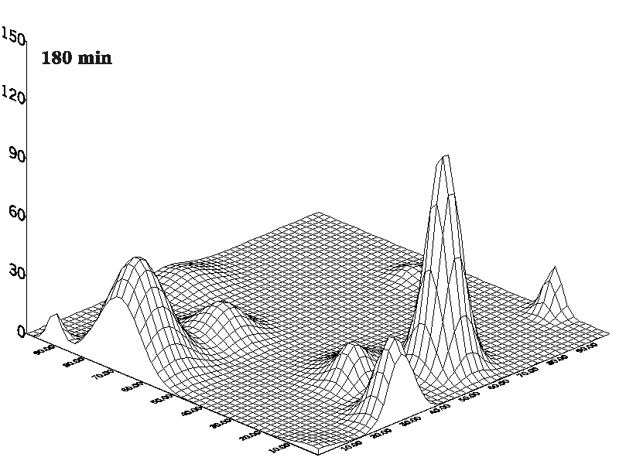
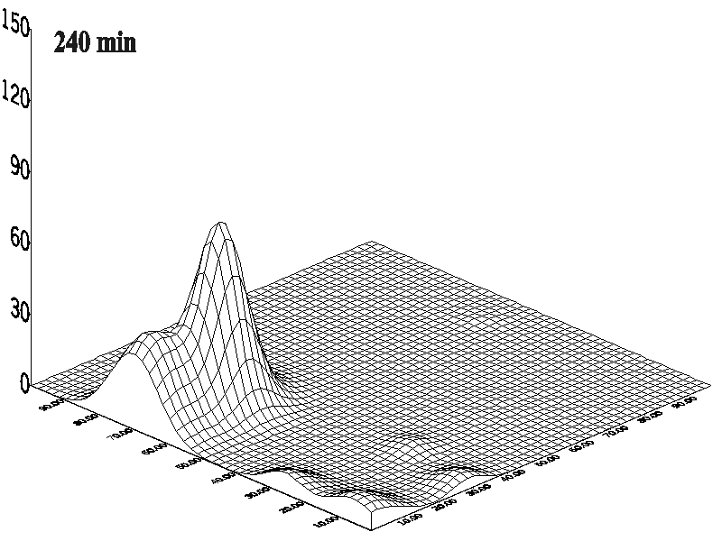
Convective storm generator
Model RAINGEN, based on the model of Rodriguez-Iturbe and Eagleson (1987) but improved by Salsón and García-Bartual (2003)
Notes:
Las tormentas son una superposición de “celdas”, cuya intensidad se determina según procesos estocásticos en el espacio y en el tiempo

Slide 18
Hydrological results at Poyo flow gauge station
Peak runoff (and hydrograph) depends highly on:
  Precipitation spatial and temporal variability
  Initial soil moisture
  200 event simulations using
  100 synthetic storms and two initial conditions

Slide 19
Flood frequency
Assuming a trivariate statistical model (Salazar et al., 2021):
    R = maximum areal 24 h precipitation
    X = peak runoff
    M = initial soil moisture with two states (dry and wet) and independent of R
Finally, it can be obtained the plotting positions for the marginal distribution of X:

Slide 20
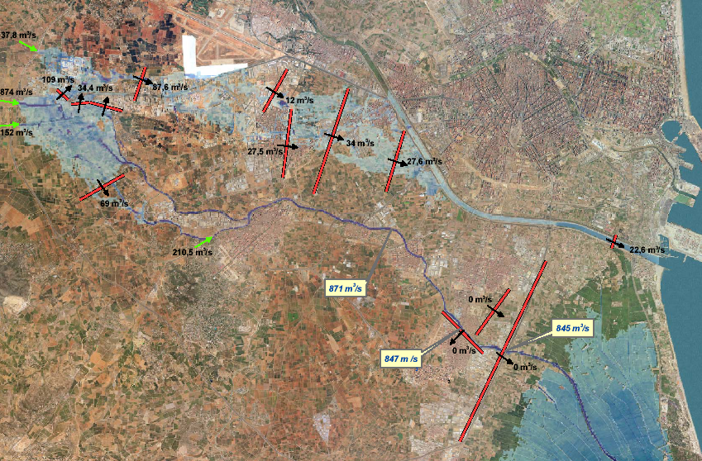
Synthetic inundation maps
Software (in 2005): Sobek 1D2D
Unfortunately, a few number of events for each scenario: 20 events for each scenario
Event 160, wet, present

Slide 21
Hazard mapping
For each cell within the inundation area, semilog linear regression for depth interpolation:

Slide 22
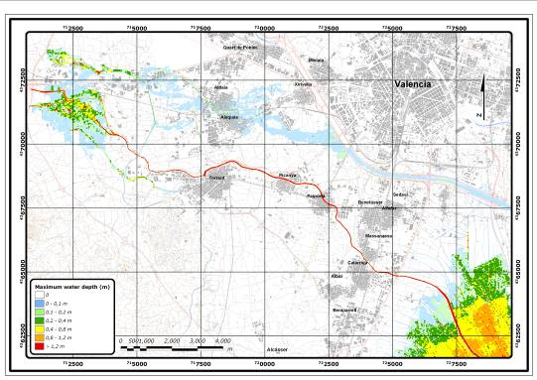
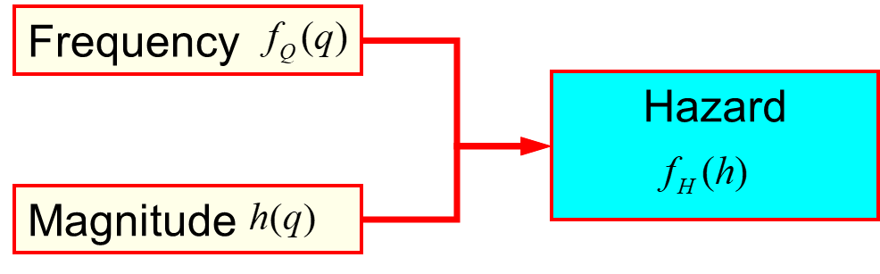
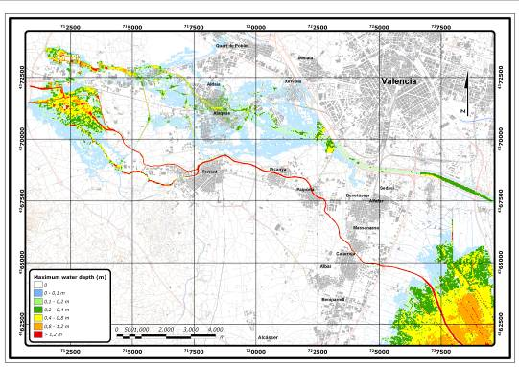
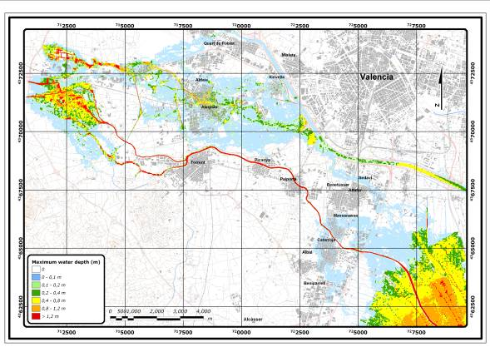
Hazard mapping
Usually, one map of magnitudes for each return period T
Maximum water depths for T= 10, 100 and 500 years in Rambla del Poyo, Southern Valencia in Spain (Francés et al, IIAMA report, 2007)
Notes:
The result of these studies is a set of hazard maps, mapping the magnitude of flooding over the territory for each required T.

Slide 23
Flood Risk in Poyo/Pozalet

Slide 24
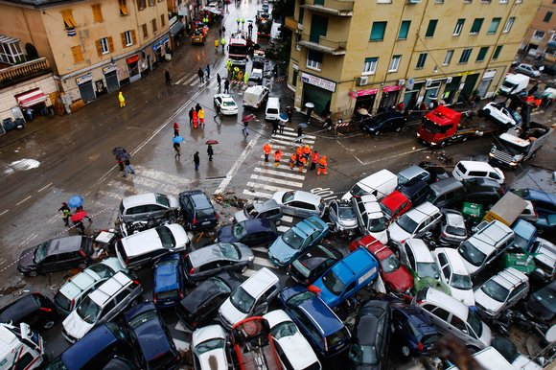
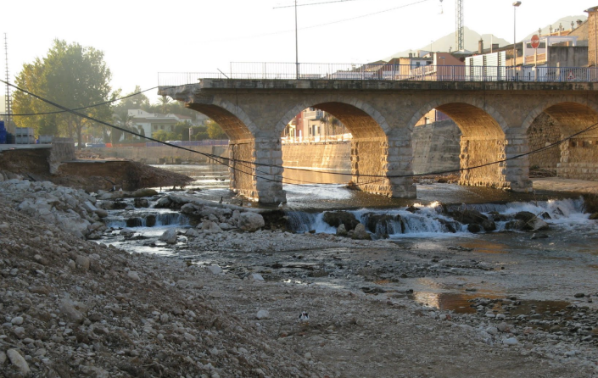
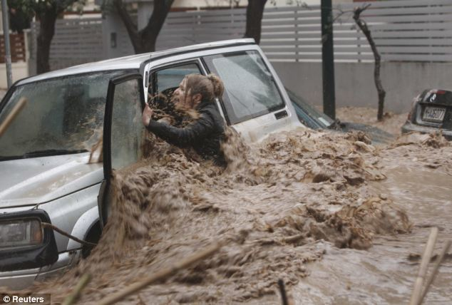
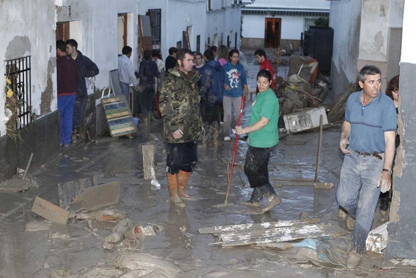
Flood damages
Tangibles: can be measured in monetary terms
  Directs
  Indirects: difficult to estimate
Intangibles

Slide 25
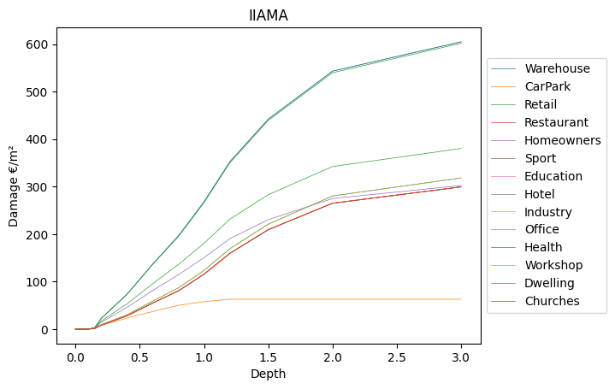
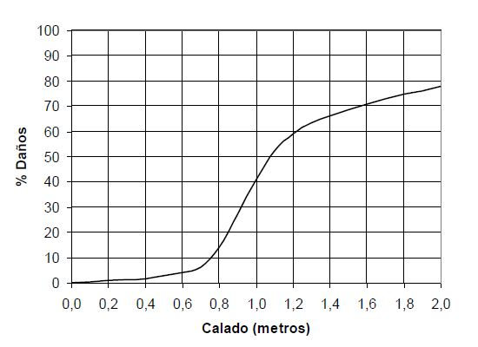

Vulnerability
Damages can potentially be produced in a point of the territory
Depends on:
  Land use (present and planned)
  Time of the year
  Magnitude: mainly maximum water depth
  Most of the total damage in urban areas
Depth-damage curves
  Case study dependent => Validate with
  historical data
$$V(h)$$
Notes:
But the risk is different. It includes the Flood damages at each point of the territory. For this reason, it is needed what is called the vulnerability curve, which defines the damages as a function of

Slide 26
Risk definition
Vulnerability
Frequency
Hazard
Exposition
Magnitude
Risk
Notes:
The proper spatial overlapping of hazard and vulnerability will give us the actual risk, that can be defined as the mean annual damage density at each point of the territory

Slide 27
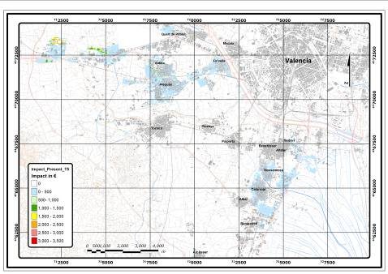
Risk mapping
that can be approximated by:
Risk density integral:
  Units: €/year/m² or affected people /year/m², or …
$$D\sim \frac{V_{10}}{2}\left(\frac{1}{T_{min}}−\frac{1}{10}\right)+\frac{V_{10}+V_{50}}{2}\left(\frac{1}{10}−\frac{1}{50}\right)+\frac{V_{50}+V_{100}}{2}\left(\frac{1}{50}−\frac{1}{100}\right)+\frac{V_{100}+V_{500}}{2}\left(\frac{1}{100}−\frac{1}{500}\right)+V_{500}\frac{1}{500}$$
  Total risk in Poyo/Pozalet = 15 M€/year (in 2006, excluding cars, cleaning and infrastructure direct costs and indirect costs)
Risk map in flood prone area of the Rambla del Poyo at present scenario (urban and industrial land use with Tmin = 5 years ). Francés et al., IIAMA report, 2007
Notes:
The proper overlapping is a complex spatial statistical integration, but it can be done easily if we have all ingredients and using a GIS
The risk is measured usually in monetary terms (euros per year an unit area), but can be also any other type of damages non measured in monetary terms as for example cars swept away or affected people
In any case, major part of the total risk is coming from urban areas

Slide 28
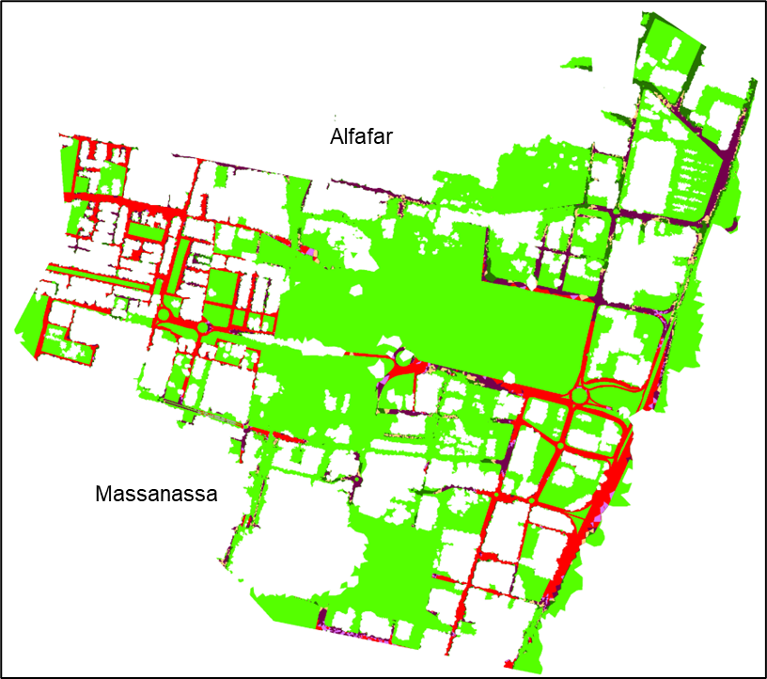
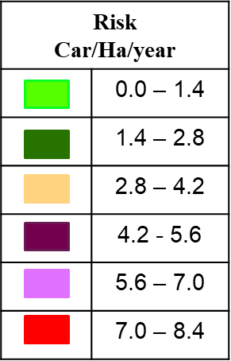
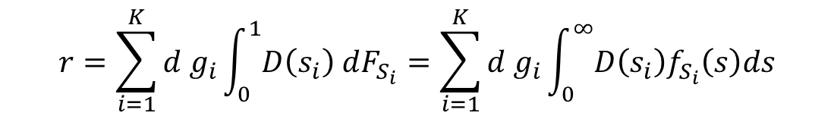

Car dragging risk map
It is defined at a given point of the territory (pixel) and is measured as the mean number of vehicles washed away per year per unit area
It can be estimated as:
where:
$D\left(s_{i}\right)$= damage function for car type i, i= 1, …, K
$s_{i}$= stability index for car type i
d = density of vehicles in this pixel
g_{i} = proportion of car type i
$$r=\sum_{i=1}^{K}{d g_{i}}\int_{0}^{1}{D\left(s_{i}\right) dF_{S_{i}}}=\sum_{i=1}^{K}{d g_{i}}\int_{0}^{∞}{D\left(s_{i}\right)f_{S_{i}}\left(s\right)ds}$$
(Bocanegra and Francés, 2021)

Slide 29
Conclusions
The objective is the risk reduction in the Inundation Area (European Directive 2007/60/EC)
The economical and social implications of flooding force maximum accuracy in the methodology to be used
In developed countries majority of victims are related with cars or flash floods
  In Poyo event both + no rainfall in inundation area
Importance of considering in the future:
  Hazard mapping of the catastrophic event (T2000?)
  Sediments in flash floods
  Cars risk and their influence in the inundation dynamics

Slide 30

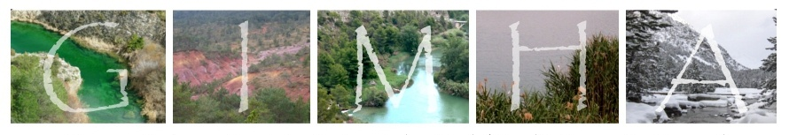
Thanks for your attention
Prof. Félix Francés (ffrances@upv.es)
Research Group of Hydrological and Environmental Modelling (GIMHA)
https://gimha.upv.es/
Solidarity Bridge (01/11/2024)

