Slide 1
IWSHCS 2026: Proposal

Slide 2
Background – IAHR Working Group on Scour Research
Working Group established in 2024, with formal opening during IWSHCS 2024, Chengdu.
Members:
Dawei Guan, Hohai University
David Furhman, DTU
Lu Wang, Sichuan University
Titi Sui, Hohai University
Hongwei An, University of Western Australia
Erik Bolleart, Aquavision Engineering
Scott Draper, University of Western Australia
Tiago Ferradosa, University of Porto
Xiaofeng Liu, Pennsylvania State University
Collin Whittaker, University of Auckland
Bruce Melville, University of Auckland
Jinhai Zheng, Hohai University
Liang Cheng, South China University of Technology
Yee Meng Chiew, Nanyang Technological University
Robert Ettema, Colorado State University
Mutlu Sumer, BM Sumer consultancy & research
Yorick Broekema, Deltares

Slide 3
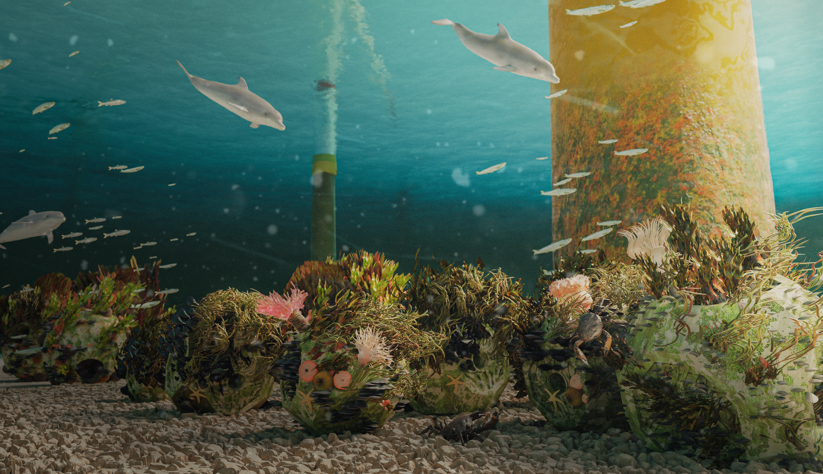
WG Strategic Agenda for 2025-2027
Five research priorities & 2 concrete actions as a template for the ‘road to Bari’ (next location for the IAHR world congress).
Research priorities
Updating Scour Design Guidelines
Improving physical modelling techniques and mitigating scale effects
AI-enhanced numerical simulations for scour predictions
Eco-friendly scour protection materials/methods
Real-time scour monitoring techniques integrating hydrological data acquisition
Actions
Host the 3rd IAHR IWSHCS 2026
Update IAHR’s 1991 Scour Design Manual by Breusers & Raudkivi.

Slide 4
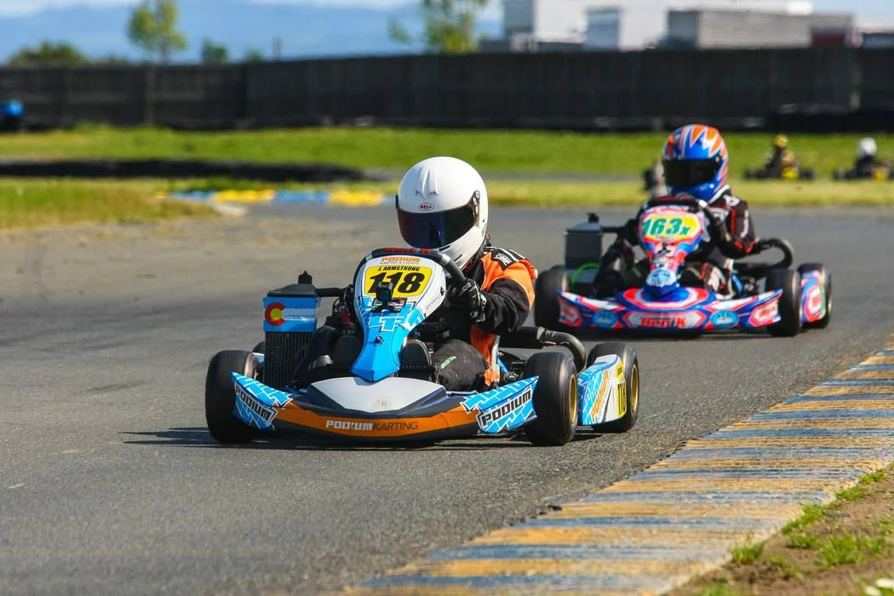
Proposal for 3rd IAHR IWSHCS
Aim: actively work on achieving shared goals AND enhance WG’s global influence.
How: hybrid format between conference and active working sessions for knowledge sharing and collecting input for the updated scour design guideline
Day 1: Welcome for WG members, pre-conference meeting and discussion to prepare for active working sessions. Short course? Welcome drinks in evening for all participants.
Day 2: Presentation day. Two keynote lectures, and ~30-40 presentations in 2/3 parallel tracks. Parallel tracks organized along the WG’s priority topics. WG member dinner.
Day 3: Working day. Two keynote lectures in the morning and a poster discussion session. Afternoon working groups for input on the scour design guideline. Plenary discussion and conference closure. Evening: conference dinner.
Day 4: Excursion (?)

Slide 5
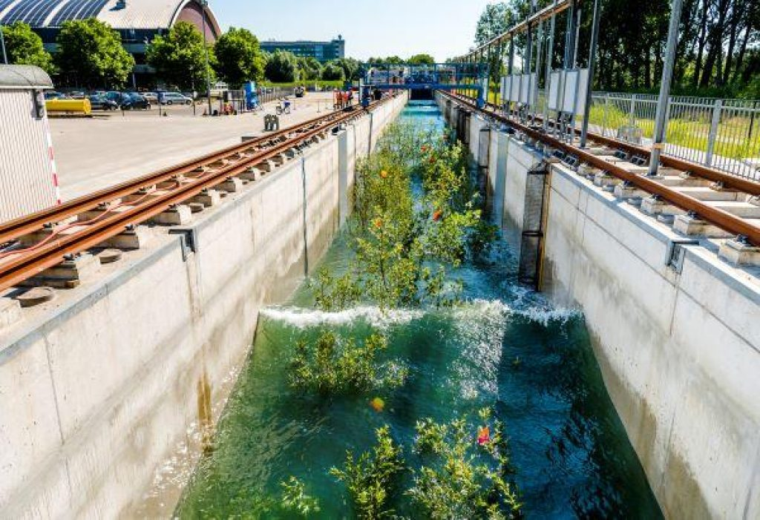
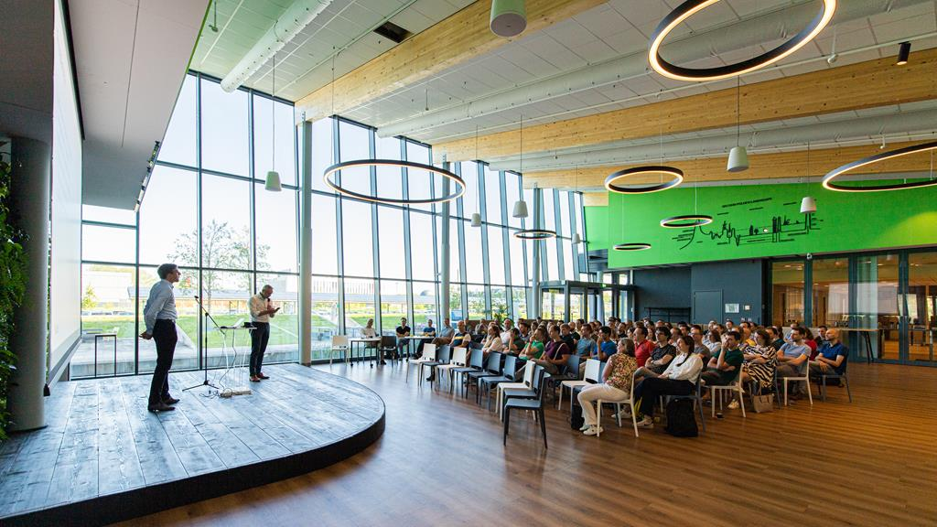
Detailed schedule
Day 2 (Tuesday): Presentations
Opening (~8.30-9.00)
Keynote lectures: 9.00-11.00 (2 lectures)
Parallel sessions on our priority areas: Physical modelling techniques and scale effects, Numerical modelling and AI/Sci-ML integration, Eco-friendly scour protection methods, Advances in real-time monitoring techniques. Session 1: 11.30-12.30 (4 presentation, 2 parallel tracks). Session 2: 14.00-15.30 (6 presentations, 2 parallel tracks). Session 3: 16.00-17.00 (4 presentations, 2 parallel tracks). Total of 28 presentations.
Conference dinner in the evening.
Day 3 (Wednesday): Working session
Keynote lectures: 8.30-10.30 (2 lectures)
Poster pitches (30 second pitch per poster).
Poster discussion session (and coffee): 11.00-12.30
Working groups for input on the scour design guideline: 14.00-15.45
Plenary discussion of received input: 16.00-16.30.
Conference closure: 16.30-17.00

Slide 6
Proposal for 3rd IAHR IWSHCS
Some thoughts:
Host at Deltares or external location? Preference for Deltares, lower cost (no external facilities required). Space limit: 100 attendees.
Make the poster session a highly relevant activity, not put them at the back somewhere.
Invite potential users of design guideline as participants and providers of input to updated guideline.
I can leverage my industry network, but then the accent moves quite strongly to offshore wind. Not my first preference, but to be discussed with WG.
Provide a platform for early-career researchers to connect and exchange ideas with experienced researchers (posters as a conversation starter?)
Collaboration (involvement) Rijkswaterstaat and TU Delft? Other parties?
No conference proceedings, only a book of abstracts (similar to NCK days).
Make business case to determine registration fee based on expected expense. Sponsorship required?

